Slide 1
IMPLEMENTATION OF SHANNON- FANO CODING IN AN ECG SIGNAL
Course Instructor: Dr. MERLIN GILBERT RAJ S, Associate Professor,
Dept ECE, KITS.
Presented by:
Kevin Philip Abraham – UTK22EC1001
Angel Mariya – URK22EC2011

Slide 2
Outline
Introduction
Market Survey
Methodology for Shannon-Fano Coding
Results and Discussions
Conclusions
References

Slide 3


Introduction
Shannon-Fano coding is a foundational algorithm in data compression, named after Claude Shannon and Robert Fano, who developed it as a way to efficiently represent data by assigning shorter codes to more frequent symbols and longer codes to less frequent ones. It is a precursor to more complex compression algorithms like Huffman coding and uses a straightforward approach to generate variable-length codes. Shannon-Fano coding was introduced in 1949
Electrocardiography (ECG) is a widely used diagnostic tool that measures and records the electrical activity of the heart.
Efficient compression of ECG signals is essential to reduce data storage, transmission bandwidth, and computational overhead without compromising the diagnostic quality of the signal.
In this project, we explore the application of the Shannon-Fano encoding algorithm to ECG signals. The goal is to compress the ECG data in a manner that preserves critical information required for accurate diagnosis while significantly reducing the file size.
This project aims to demonstrate the effectiveness of Shannon-Fano encoding in ECG data compression and provide insights into its potential use in medical applications.

Slide 4
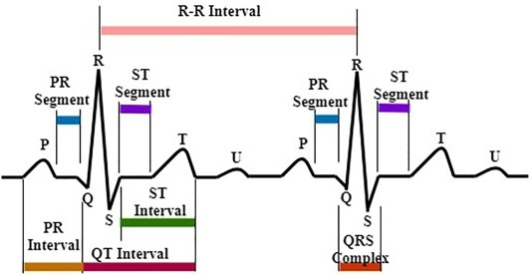
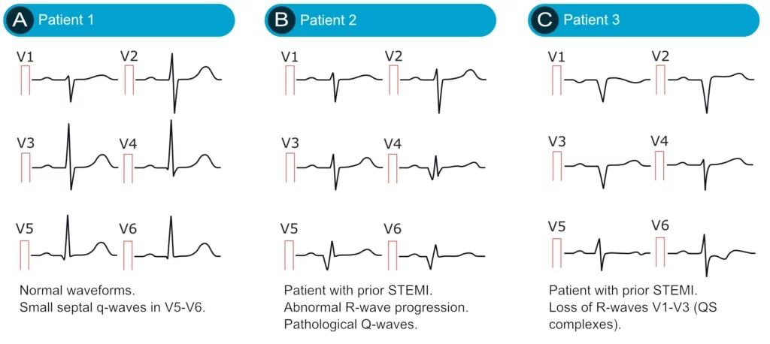
Market Survey
Latest technologies used in ECG data compression:
Transform-based Compression: Techniques like Fourier Transform (FT), Wavelet Transformation (WT), and Discrete Cosine Transform (DCT) help compress ECG data by encoding essential frequency information. While effective, these methods may sacrifice critical signal details and add computational complexity, making them less suitable for real-time portable applications.
Binary Convolutional Auto-encoder (BCAE) with Residual Error Compensation (REC): The BCAE model introduces binary compressed code generation, boosting compression while preserving quality. Integrated with REC, this approach refines reconstruction accuracy by compensating for errors, making it ideal for portable ECG systems that demand both efficiency and fidelity in data transmission.

Slide 5
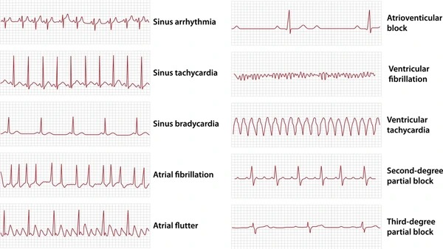
Market Survey
Deep Learning Compression with Auto-encoders: Deep learning methods, especially those involving convolutional auto-encoders (CAEs), enable end-to-end compression without extensive pre-processing. Auto-encoders learn efficient low-dimensional representations, achieving high compression with minimal signal degradation. However, trade-offs between compression ratio and reconstruction quality remain a concern.

Slide 6
Methodology for Shannon-Fano Coding
Step No:1
Load ECG DATA: Load the ADC-converted ECG signal data from PhysioNet, with a total sample size of 147,499 representing combined data from 20 people.
Step No:2
Probability Calculation: Count the occurrences of each unique ADC value in the dataset. Calculate the probability of each ADC value by dividing its occurrence by the total number of samples
Step No:3
Sort Probabilities: Sort the ADC values in descending order based on their probabilities.
Step No:5
Assign Binary Codes: Recursively divide the groups, assigning ‘0’ and ‘1’ until every ADC value has a unique binary code..

Slide 7
Methodology for Shannon-Fano Coding
Step No:4
Recursive Shannon-Fano Partition: Split the sorted list of ADC values into two groups such that the cumulative probabilities of each group are as equal as possible. Assign binary codes: ‘0’ to values in the first group and ‘1’ to values in the second group.
Step No:5
Assign Binary Codes: Recursively divide the groups, assigning ‘0’ and ‘1’ until every ADC value has a unique binary code.
Step No:6
Encode the ECG Signals: Replace each ADC value in the dataset with its corresponding Shannon Fano code
Step No:5
Assign Binary Codes: Recursively divide the groups, assigning ‘0’ and ‘1’ until every ADC value has a unique binary code..

Slide 8
Methodology for Shannon-Fano Coding
Step No:7
Store Encoded Data: Store the encoded ECG signals in an Excel file, with each row representing the encoded signals for each sample
Step No:8
Calculate Compression Metrics: Entropy(H), Average code word length, Efficiency (η), Variance of Code Lengths (σ²).
Step No :9
Analyse Metrics as Number of People Increases: Start with the ECG data of 1 person and incrementally add more people to the dataset. At each step, calculate the metrics: entropy, average code word length, efficiency, and variance. Record the metrics for 1 person, 2 people, and so on, up to 20 people.group.
Step No:5
Assign Binary Codes: Recursively divide the groups, assigning ‘0’ and ‘1’ until every ADC value has a unique binary code..

Slide 9
Methodology for Shannon-Fano Coding
Step No:10
Store Results in Excel: Save the calculated metrics and graphical results in an Excel file for further analysis.
Step No:11
Generate Graphical Results: Plot the following graphs: 1. Entropy vs. number of people. 2. Average code word length vs. number of people. 3. Efficiency vs. number of people. 4. Variance of code word lengths vs. number of people.
Step No:5
Assign Binary Codes: Recursively divide the groups, assigning ‘0’ and ‘1’ until every ADC value has a unique binary code..

Slide 10

Methodology for Shannon-Fano Coding
Metrics Formulas
Step No:5
Assign Binary Codes: Recursively divide the groups, assigning ‘0’ and ‘1’ until every ADC value has a unique binary code..

Slide 11
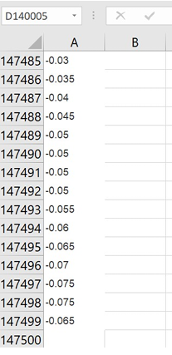
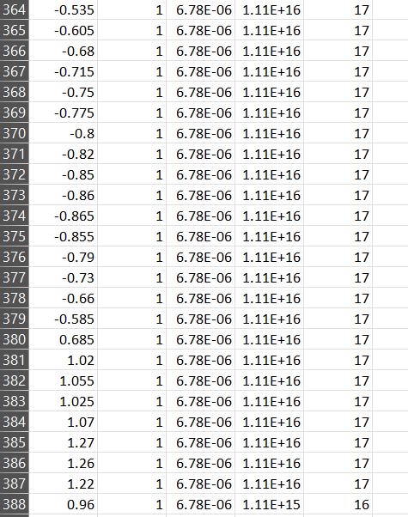

Results and Discussions
Sampled and filtered data sets of 20 people (147499 samples)
Shannon-Fano coded data (388 code words)

Slide 12
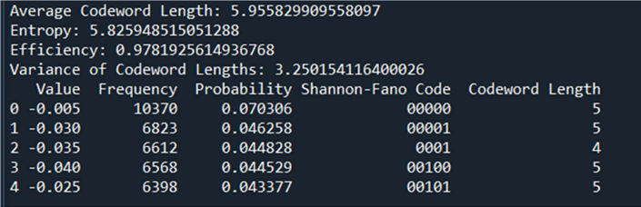
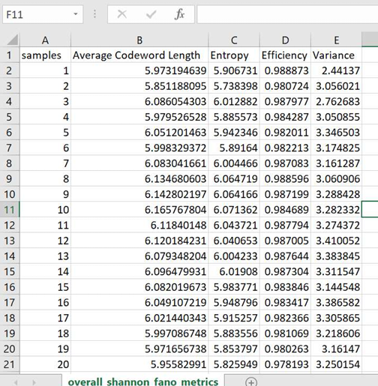
Results and Discussions
Shannon-Fano Metrics (20 People Dataset):
Shannon Fano Metrics with Varying Sample Size

Slide 13
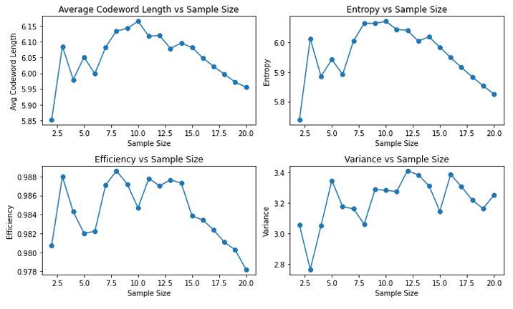
Results and Discussions
Graphical Plot

Slide 14
Conclusions
In this project, we successfully implemented Shannon-Fano coding to compress ECG signals from a dataset comprising 147,499 samples collected from 20 individuals.
The coding process generated 388 unique code words, leading to notable metrics that highlight the efficiency and effectiveness of the compression. The average codeword length was approximately 5.96 bits, while the entropy of the encoded data was calculated to be around 5.83 bits, indicating a high degree of information representation with minimal redundancy.
The achieved efficiency of 0.98 underscores the effectiveness of the Shannon-Fano coding technique in this context, and the variance in codeword lengths, measured at approximately 3.25, reflects the diversity in signal characteristics across different ECG readings.

Slide 15
Conclusions
Looking ahead, potential improvements could include exploring adaptive coding techniques or integrating machine learning algorithms to enhance the compression process further. Additionally, extending the dataset to include a wider variety of ECG signals from diverse demographics could improve the model's robustness.
The applications of this work in healthcare are significant, particularly in telemedicine and remote patient monitoring systems.
Efficient compression of ECG signals can facilitate faster transmission of vital health data over limited bandwidths, enabling timely diagnosis and monitoring of patients' cardiac health.
Ultimately, advancements in data compression techniques like Shannon-Fano coding will contribute to the development of more efficient and effective healthcare technologies, improving patient outcomes and optimizing resource utilization.

Slide 16
References
Communication Systems, Simon Haykin, Wiley, Fourth Edition.
Oppenheim, A. V., & Willsky, A. S. (1997). Signals and Systems. 2nd Edition. Prentice Hall.
LW: .../1.0.0/Person_01/rec_1 (physionet.org)

